Slide 1


Business Intelligence & Data Engineering Project Team 5
BI Pipeline for Melodica Media Corp.
https://github.com/49panagos/project-future

Slide 2




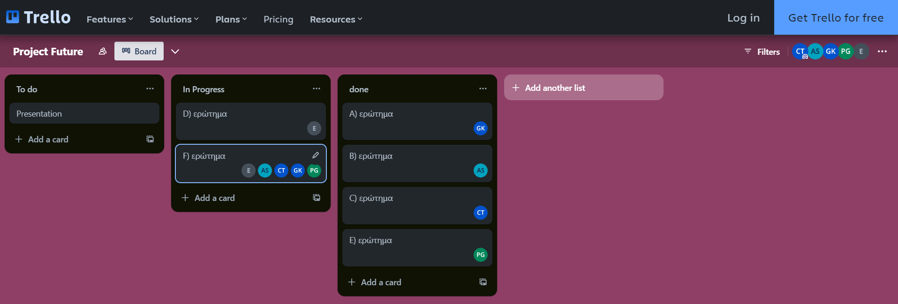

Trello Project Management Tool
Panagiotis Georgiadis
Christos Theodoropoulos
Ioannis Kastorinis
Afroditi Syleloglou
Eleni Charitoudi

Slide 3
Project Scope
Staging Area DB
DW DB
SSAS
Power BI Visualizations
SSIS

Slide 4
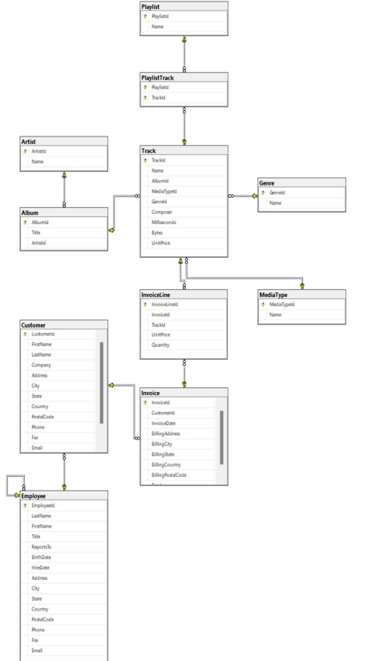
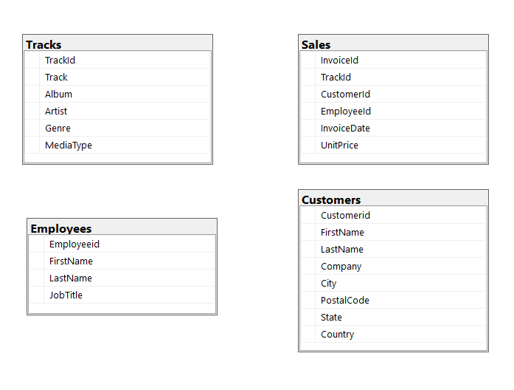
Chinook - Database
Staging

Slide 5
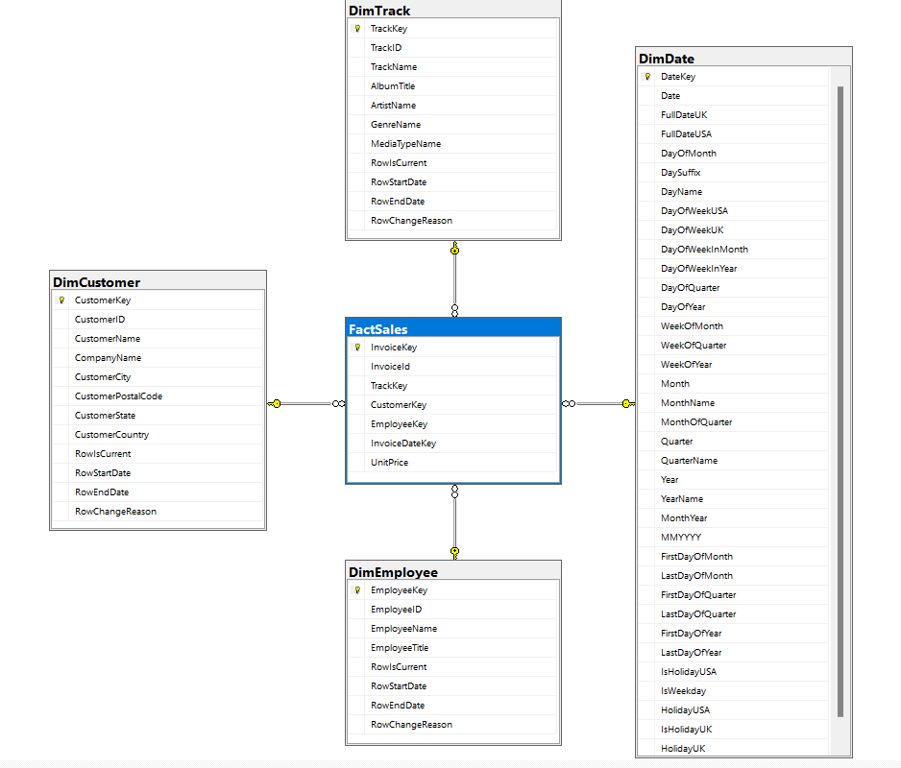
DW- Star Schema

Slide 6

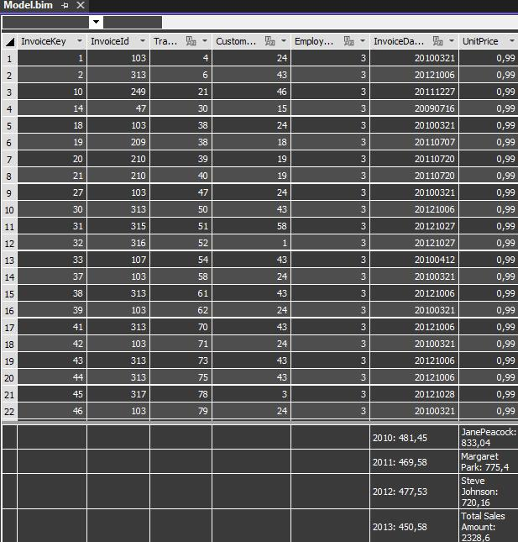
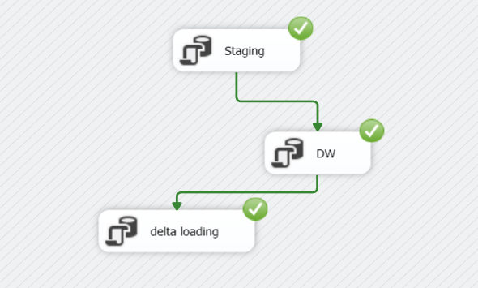
SSAS
SSIS
Delta loading for FactSales
DAX measures on SSAS

Slide 7
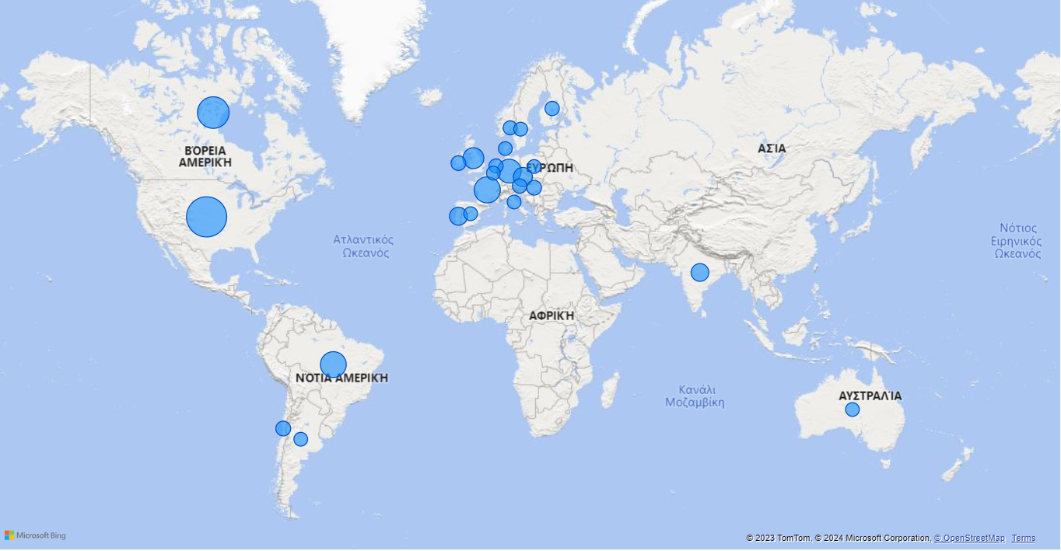
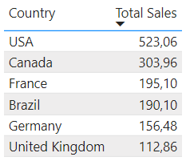
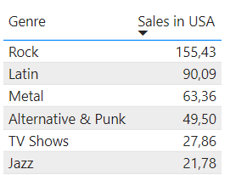
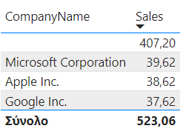
Sales per Country
#Top 6
#Top Genre in USA
Companies in USA

Slide 8
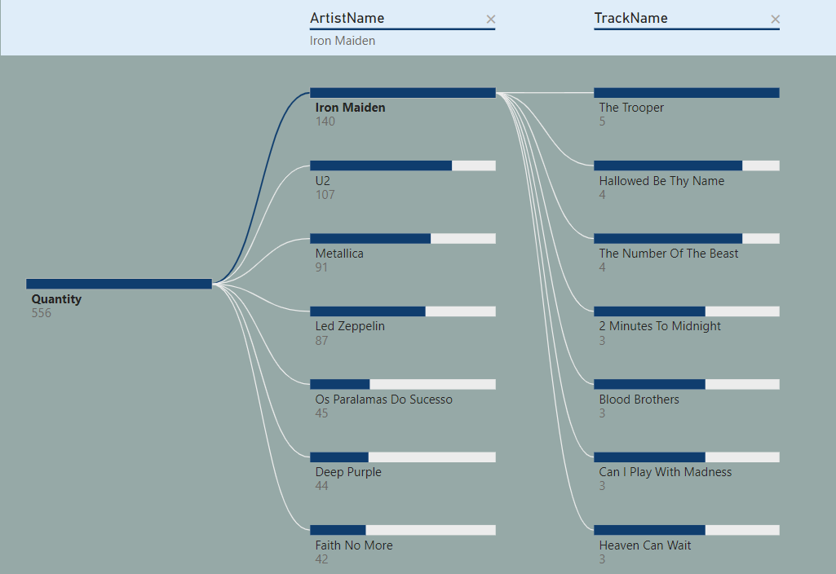
2009-2013
2013
#Top Artist
#Top Album
QUEEN
Lost, Season1
#Top Hit
Stranger in a Strange land

Slide 9
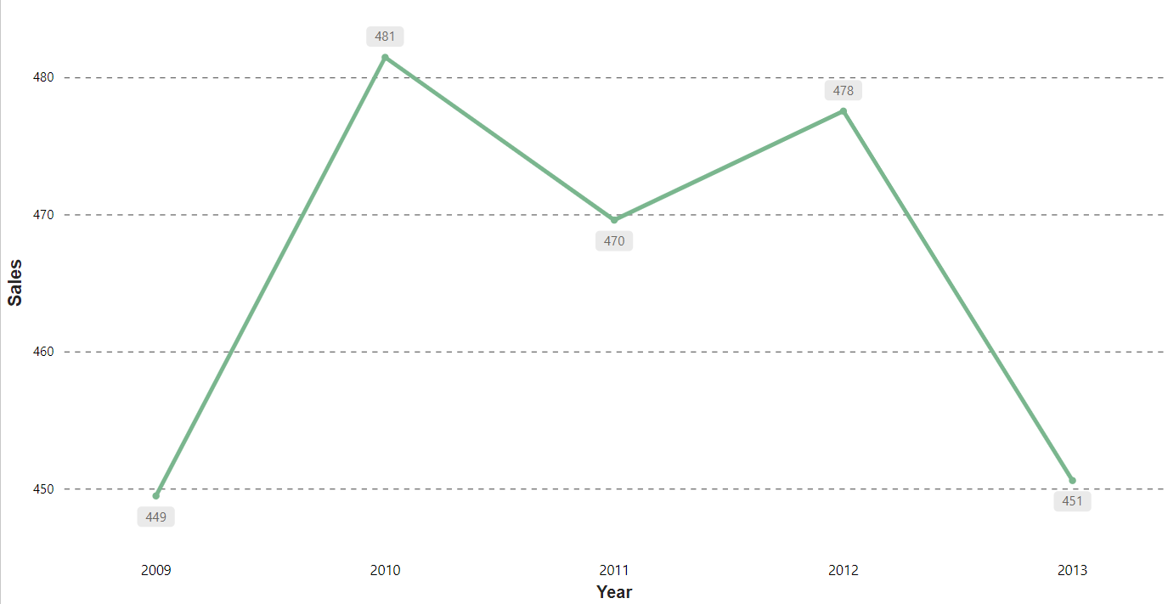
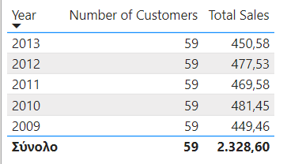
Total Sales per Year
2013 decrease
Little total profit
Best Year 2010
Stable number of Customers
Need for advertising

Slide 10
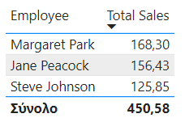
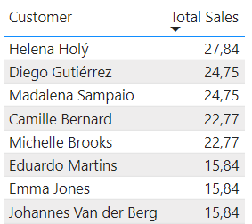
People of the Year
Margaret Park is the top Employee of 2013, and so she will get a bonus!
Helena Holý is the top Customer of 2013, and so she will get a discount code!

Slide 11
Ευχαριστούμε!!

